Slide 1
Types of Testing
SQA: Manual & Automated Testing

Slide 2
Functional Testing
Non Functional Testing
Checks specific functionality, features, and behaviors of the software
Unit Testing
Integration Testing
System Testing
User Acceptance Testing (UAT)
Evaluates system qualities and performance under various conditions
Performance Testing / Load Testing
Security Testing
Stress Testing
Usability Testing
Checks “What” the system does
Checks “How” the system performs

Slide 3
Black Box
White Box
Valid login from UI and API
Login by Manual and Automation
Valid login with actual method
function login(email, password){
if(email == valid && password == valid){
expect(msg).toeql(“Valid Login”);
}else{
expect(msg).toeql(“Invalid Login”);
}
}
Email
Password
Login
POST request: {baseUrl}/login
{
“email”: “test@yopmail.com”,
“password”: “pass123456”,
}
login(test@yopmail.com, pass123456);
login(testyopmail.com, 112233);

Slide 4
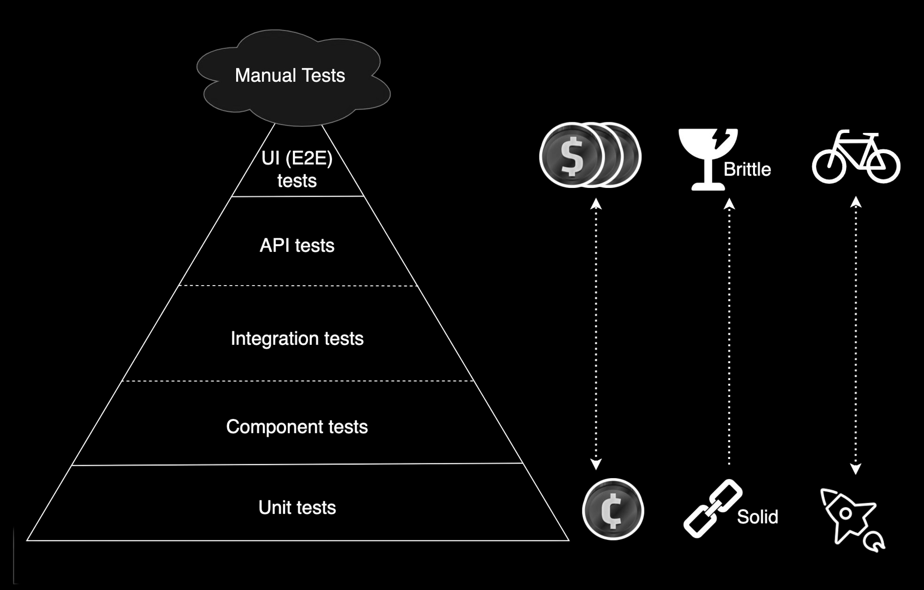
Testing Pyramid

Slide 5
Testing Methods
Smoke Testing
Sanity Testing
Regression Testing
Exploratory Testing
System Testing
Acceptance Testing / UAT (User Acceptance Testing)
Integration Testing

Slide 6
Smoke testing
Smoke testing is a quick, preliminary test suite designed to verify that the core functionalities of a new build are working before more extensive testing begin.
It is a subset of acceptance testing. And the term “smoke testing” comes from the hardware testing practice of turning on a new piece of hardware for the first time and considering it a success if it does not catch fire or smoke.
The objective of smoke testing is to verify the “stability” of the system.
When to do smoke testing?
When a new build/version is deployed to Staging or Pre-production or Code merge
Before Major Testing Phases like, regression testing, user acceptance testing (UAT), or performance testing,
Before Demonstrations or Reviews.

Slide 7
Sanity testing
Sanity testing is a software testing process that verifies the core functionality of a software application after making minor changes or bug fixes
It is a subset of regression testing
Unlike smoke testing, sanity testing is more focused and in-depth, concentrating on specific functionalities rather than the entire application.
When to do sanity testing?
When a new build/version is deployed to Staging or Pre-production or Code merge
After Bug Fixes or Minor Code Changes
When a new feature is build

Slide 8
Regression testing
Regression testing is a process that ensures that new changes, like bug fixes or new features, haven't introduced any unexpected issues or broken existing functionality.
It involves re-running tests that previously passed to verify that the software still works as expected after changes.
It is focused on thoroughness and attention to detail, involving the execution of all existing test cases and scenarios
When to do regression testing?
When new functionality is added to the system and the code has been modified
When some defect has been identified in the software and the code is debugged to fix it.
When the code is modified to optimize its working.

Slide 9
Exploratory testing/Ad-hoc testing
Exploratory testing is a software testing approach where testers actively explore a system, identifying issues and assessing user experience without relying on pre-written test cases.
SQA or testers use their learning, knowledge, skills, and abilities to test the software
Exploratory testing was first named “ad-hoc testing”. The “exploratory testing” was named by the software testing expert Cem Kaner in the classic book, Testing Computer Software.
When to do exploratory testing?
When a new tester joins and needs to learn quickly about the application and provide rapid feedback.
when there is a need to review products from a user perspective.
When to ensure that the tester doesn’t miss the edge cases that can lead to critical quality failures.

Slide 10
System testing
System testing, also known as end-to-end testing,
System testing evaluates the complete and integrated system to ensure it meets specified requirements.
System testing is performed after integration testing and involves testing the entire application as a whole to ensure that all components work together correctly
When to do system testing?
When to cover the end-to-end functions of a system, and to provide reliability to the system
When to test the entire system architecture as per the business requirement.
When to simulates real-world scenarios to identify defects and confirm that the software behaves as expected in a production-like environment

Slide 11
Acceptance testing / UAT (User Acceptance Testing)
Acceptance testing is a crucial phase of testing where the final product is evaluated by end-users or stakeholders to ensure that it meets all the requirements and is ready for deployment.
It verifies whether the software functions as planned, meets user expectations, and aligns with business goals.
Essentially, it's the "go/no-go" decision point where the customer validates the product's suitability before release.
When to do acceptance testing?
When to find the defects missed during the functional testing phase.
When to improve the product performance and real user experience.
When to minimize or eliminate the issues arising from the production.

Slide 12
Integration testing
Integration testing verifies how separate modules or components of a software application interact and work together as a cohesive unit.
It ensures that data flows correctly between these modules and that the combined functionality meets the overall system requirements.
Imagine you have several building blocks. Integration testing is like putting those blocks together to see if they fit and work correctly as a structure, not just individually.
When to do integration testing?
When to identify any bug that arise when different components are combined and interact with each other
When to verify that the expected sequence is followed.

Slide 13
Full Cycle testing
Full Cycle Testing means performing continuous testing across all phases of the Software Development Life Cycle (SDLC) — including planning, design, development, deployment, and maintenance.
  It validates that the software meets both functional and non-functional requirements at every stage.
  It ensures that data flows correctly between these modules and that the combined functionality meets the overall system requirements.
Imagine you have several building blocks. Integration testing is like putting those blocks together to see if they fit and work correctly as a structure, not just individually.
When to do Full Cycle Testing?
From the beginning to end of SDLC
When to verify covers all types: reviews requirements, unit, integration, system, acceptance, regression, etc.
That entire ongoing process — from idea to post-release validation — is Full Cycle Testing.

Slide 14
Few More Testing Techniques
End-to-End Testing (E2E): Testing the complete workflow of an application from the user’s perspective; from start to finish.
Alpha Testing: Internal testing conducted by the development or QA team before releasing the software to external users. It is done in a controlled environment to catch bugs early.
Beta Testing: External testing conducted by real users or a limited audience outside the development team. It is done in the real-world environment to gather feedback and identify issues that weren’t caught internally.
Compatibility Testing: Ensures the application works on different browsers, devices, OS, or hardware.
Usability Testing: Tests the application’s user-friendliness.

Slide 15
Few More Testing Techniques
Boundary Value Analysis (BVA): Focuses on the edges of input ranges
Equivalence Partitioning (EP): Divides input data into groups that are expected to behave the same

Slide 16
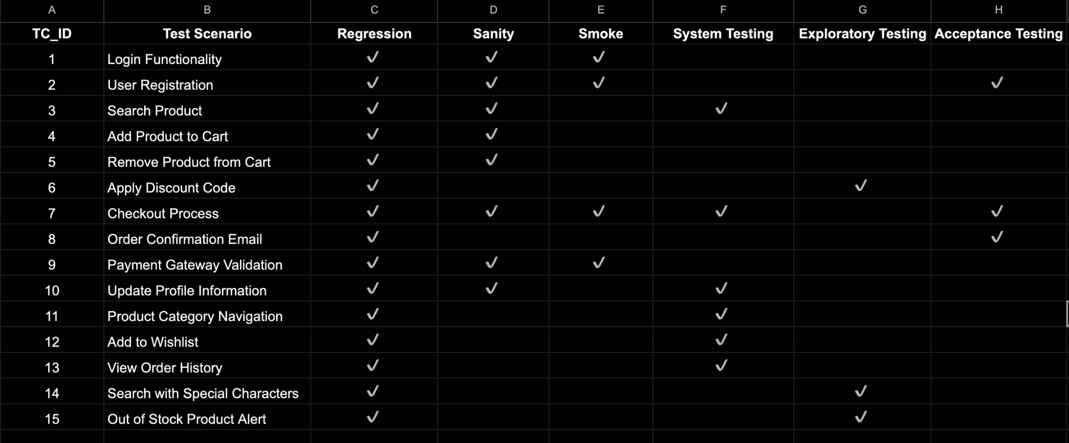
Testing Methods
URL: Testing Methods

Slide 17
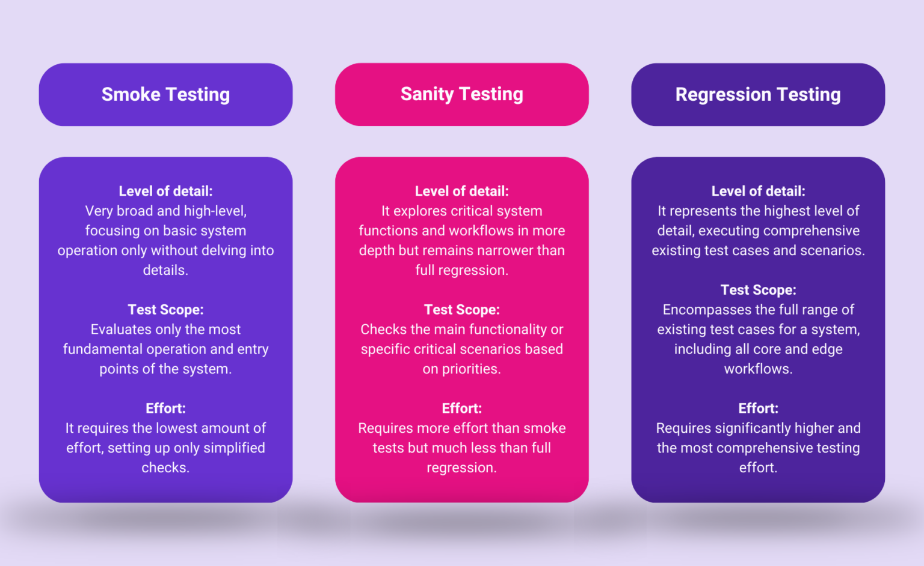

Slide 18
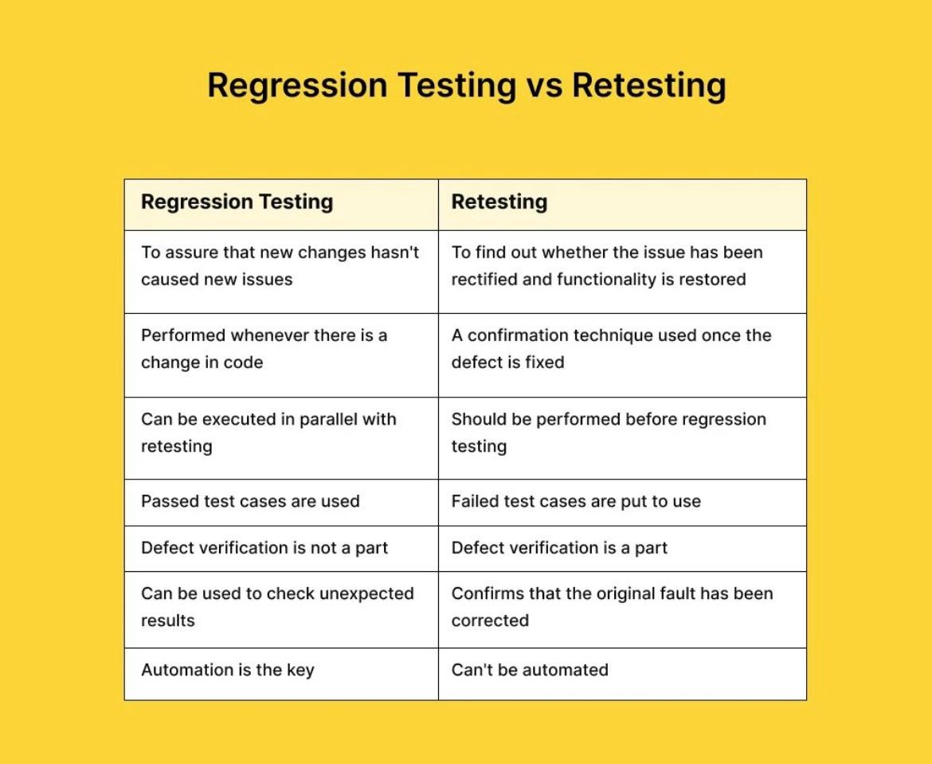

Slide 19
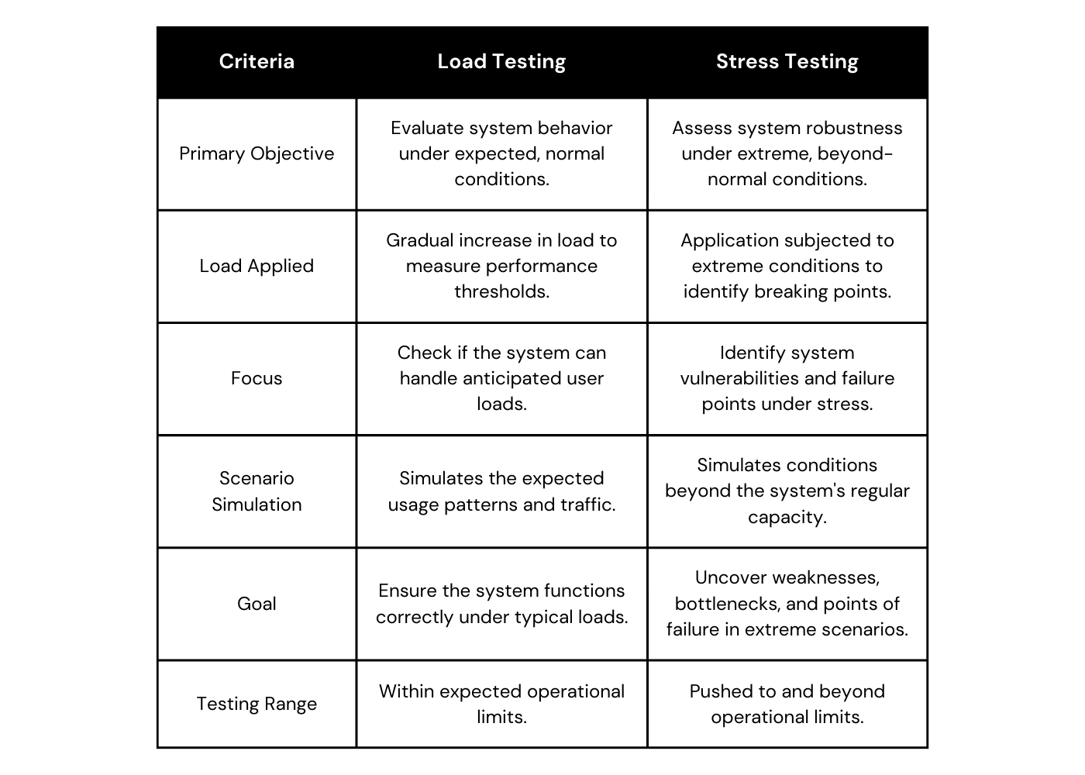

Slide 20

Any Questions?
Thank you!

